Slide 1
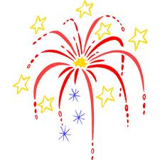
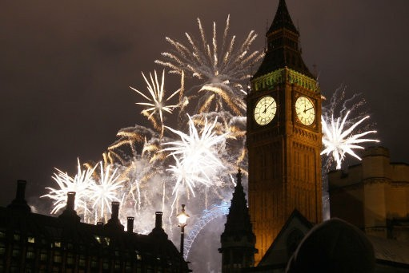
Guy Fawkes’ Night
November 5th
Notes:
http://www.ibtimes.co.uk/articles/274979/20120101/world-celebrates-advent-2012-balloons-fireworks-video.htm

Slide 2
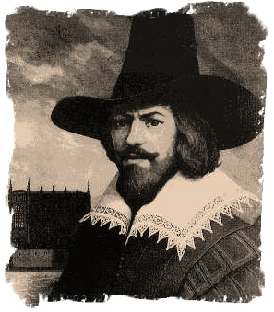
Who was Guy Fawkes?
Guy Fawkes was a man who lived a very long time ago (more than 400 years ago!)
Notes:
http://www.superinterestingfacts.com/guy-fawkes-in-ten-facts/

Slide 3
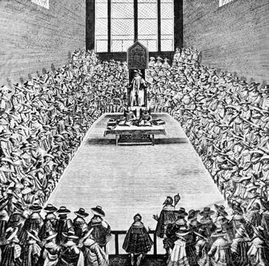
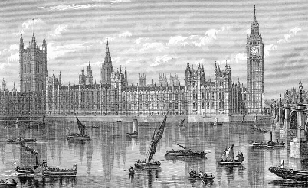
Guy Fawkes’ thinking
King James I and his men helped our country. They worked in the Houses of Parliament. Guy Fawkes didn’t like those people.
Notes:
http://www.london-architecture.info/LO-112.htm

Slide 4
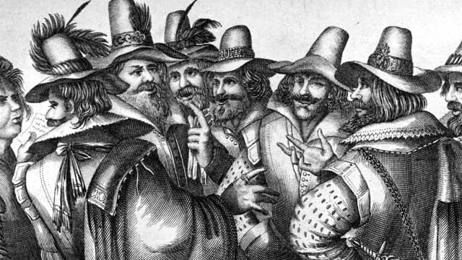
Guy Fawkes’ plan
So, Guy Fawkes and his friends came up with a terrible plan.
Notes:
http://www.bbc.co.uk/newsround/15351828

Slide 5
Guy Fawkes’ plan
They were going to blow up the building that King James I and his men worked at, the Houses of Parliament.

Slide 6
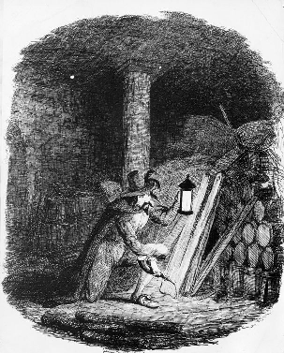
Guy Fawkes’ plan
Guy Fawkes and his friends put 36 barrels of gunpowder in the cellar under the Houses of Parliament.
They wanted to blow up the Houses of Parliament. The date was November 5th, 1605.
Notes:
http://www.lindsayfincher.com/remember-remember-the-fifth-of-november-gunpowder-treason-and-plot.html

Slide 7
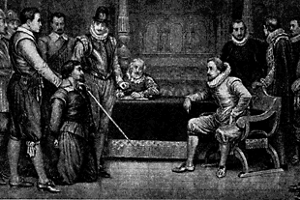
Guy Fawkes caught
But luckily, Guy Fawkes and his friends were caught before they could blow up the building. They were all punished.
Notes:
http://www.factmonster.com/spot/guyfawkes.html

Slide 8
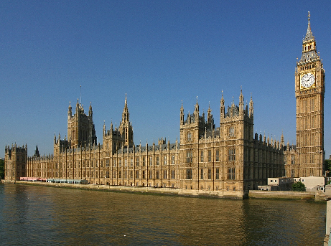
Today
The Houses of Parliament are still here today.
Notes:
http://www.londonvisitplaces.com/attractions/houses-of-parliament-tours

Slide 9
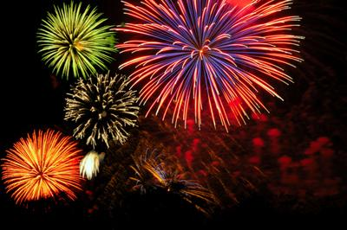
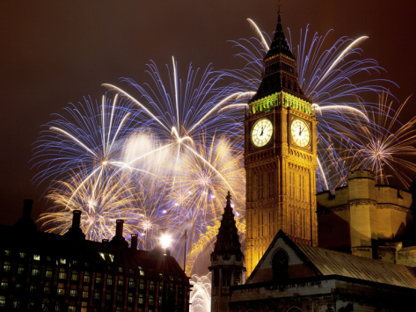
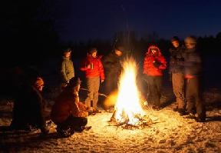
Celebrating November 5th
On November 5th, we light fireworks and bon fires to celebrate the date when Guy Fawkes and his friend got caught.
Notes:
http://entertainmentguide.local.com/bonfire-crafts-kids-1463.html
http://www.art.co.uk/products/p14214987552-sa-i6647018/frank-fell-new-year-fireworks-and-big-ben-houses-of-parliament-westminster-london-england-united-kingdom.htm

Slide 10
Fire safety
Bonfires and fireworks are very dangerous. Never light a bonfire, firework or sparkler yourself.

Slide 11
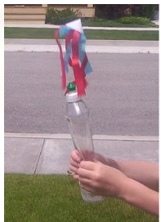
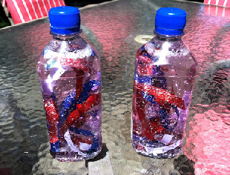
Activity Ideas
Here are some other ways you can celebrate November 5th!
See here for more ideas, and links to original blogs:
the-hotairballoon.weebly.com
Notes:
http://homeinspiredbliss.blogspot.co.uk/2012/06/fireworks-in-bottle.html
http://almostunschoolers.blogspot.co.uk/2010/07/soap-bottle-air-rockets-4th-of-july-fun.html

